Slide 1
Climate and Soils
September 10, 2019

Slide 2
Climate

Slide 3
Climate = long term average weather
A = tropical
B = arid
C = temperate
D = cold
E = polar

Slide 4
Why do we care about climate?

Slide 5
Earth’s Energy Budget

Slide 6
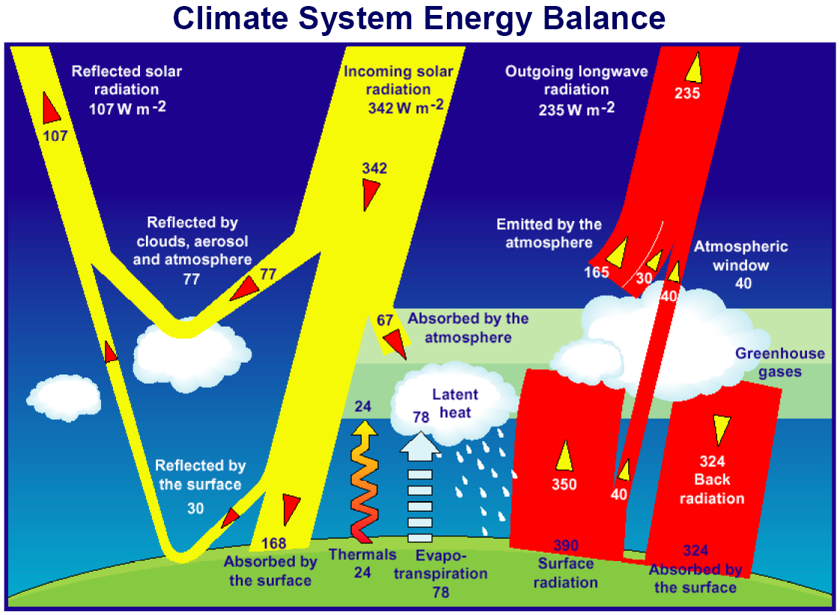

Slide 8
Aerosols
Atmospheric particles
Reflect incoming radiation back to space
What’s the climate impact?

Slide 9
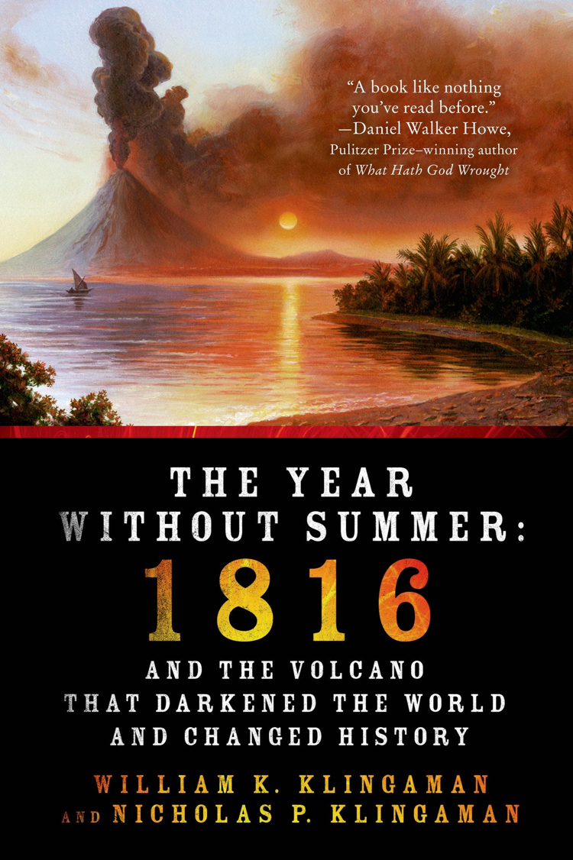
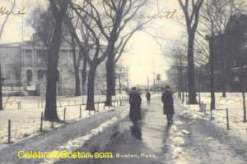
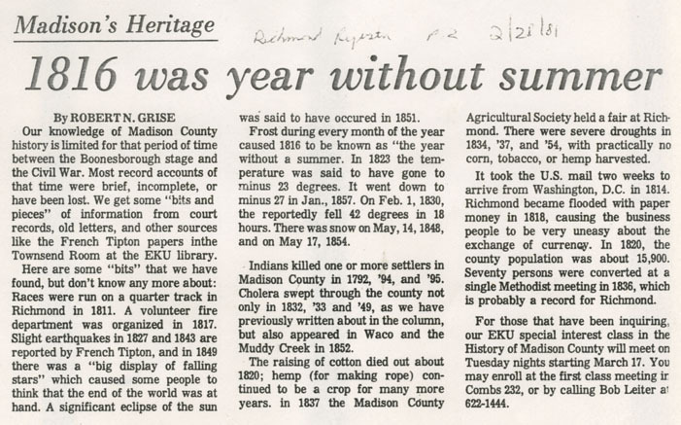
June 6th, 1816
Mount Tambora erupts (April 5th, 1815)

Slide 12
Albedo
Radiation reflected by a surface
High degree of variability in albedo of Earth’s surface

Slide 13
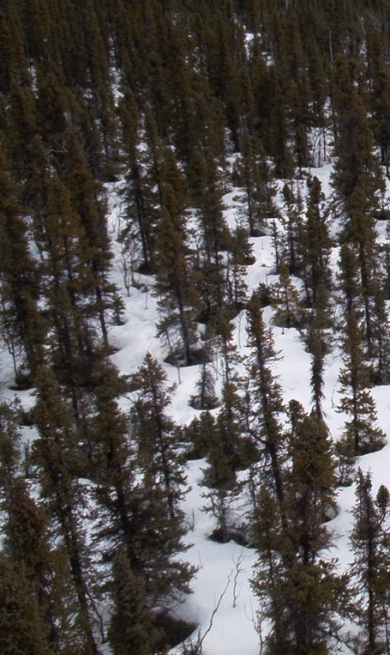
Albedo Examples
Oceans/lakes 0.03-0.10
Sea ice 0.30-0.45
Fresh snow 0.75-0.95
Tundra 0.15-0.20
Conifer forest 0.09-0.15
Broadleaf forest 0.15-0.20
Desert 0.20-0.45
Soil (wet) 0.05
Soil (dry) 0.40

Slide 14
Albedo Examples
Oceans/lakes 0.03-0.10
Sea ice 0.30-0.45
Fresh snow 0.75-0.95
Tundra 0.15-0.20
Conifer forest 0.09-0.15
Broadleaf forest 0.15-0.20
Desert 0.20-0.45
Soil (wet) 0.05
Soil (dry) 0.40
Can you rank these?

Slide 15
Amount reflected
Oceans/lakes 0.03-0.10
Sea ice 0.30-0.45
Fresh snow 0.75-0.95
Tundra 0.15-0.20
Conifer forest 0.09-0.15
Broadleaf forest 0.15-0.20
Desert 0.20-0.45
Soil (wet) 0.05
Soil (dry) 0.40

Slide 17
Greenhouse gases
Trap outgoing longwave radiation
Act like a blanket over the Earth’s surface
Keep us warm!

Slide 18
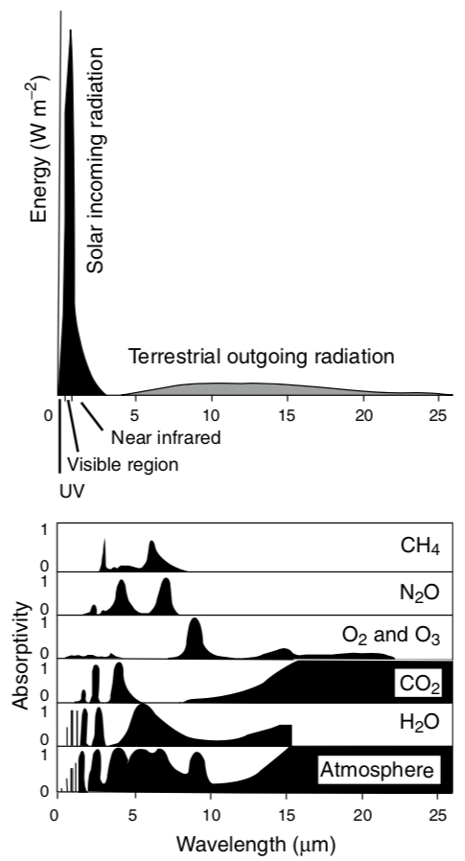
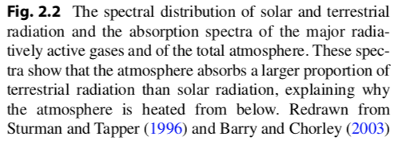

Slide 19
NOAA

Slide 20
Topography

Slide 21
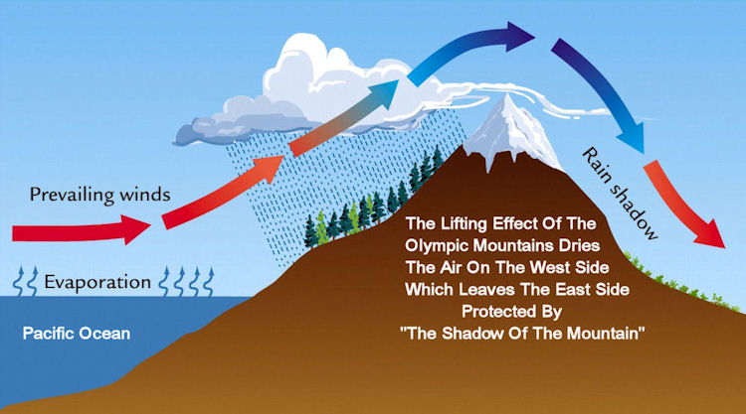
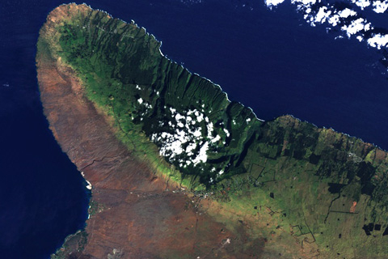
Rain Shadows

Slide 22
Vegetation

Slide 23
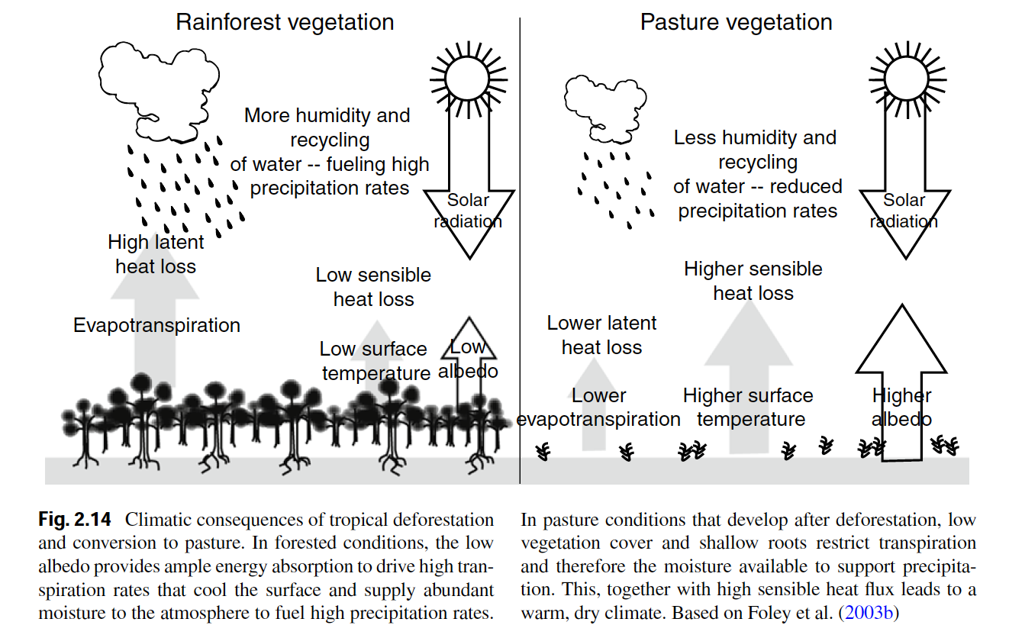
Vegetation itself can change climates

Slide 24
Long-term climate

Slide 25
Without humans would climate change over time?

Slide 26
Without life on Earth would climate change over time?

Slide 27
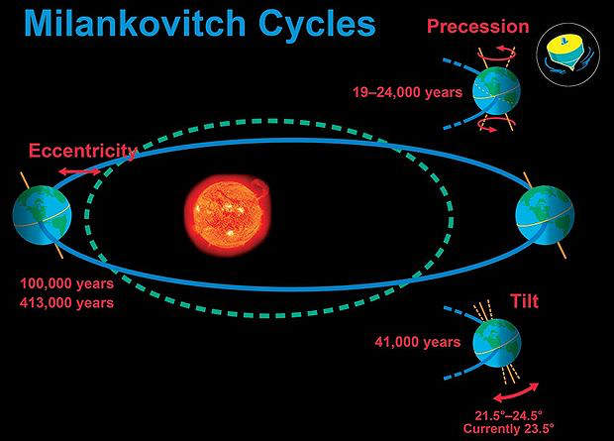

Slide 29
Soils

Slide 30
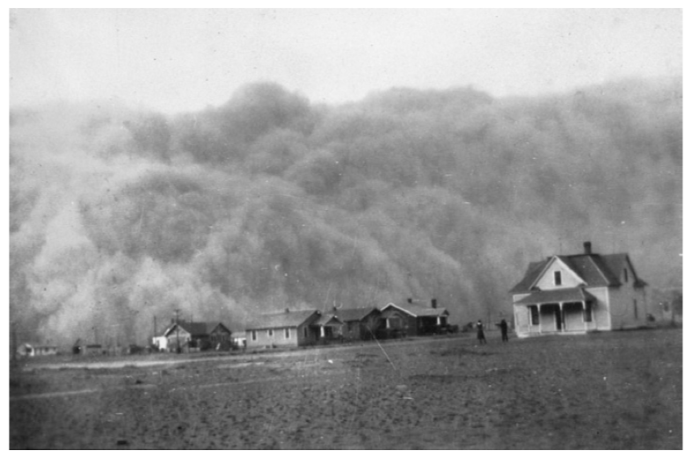
Soil Erosion and Formation

Slide 31
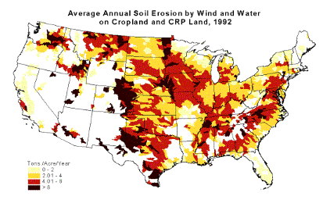
Soil Erosion

Slide 32
Erosion
Transfers carbon, nutrients and sediment from terrestrial to aquatic ecosystems
Often occurs faster than soils can be rebuilt
Leads to loss of fertility of agricultural soils

Slide 33
Formation: State factors
Parent material
Climate
Organisms
Topography/Relief
Time

Slide 34
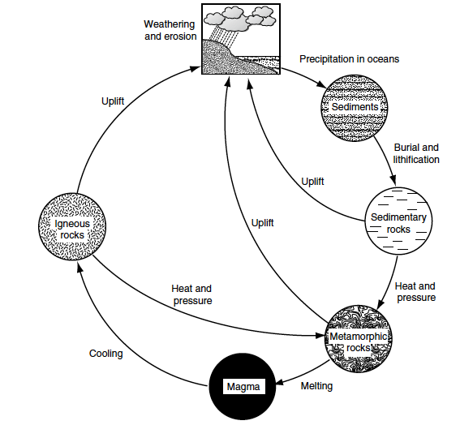
Parent Material
Physical and chemical properties of rocks
Uplift and weathering occur at different rates
100-200my

Slide 35
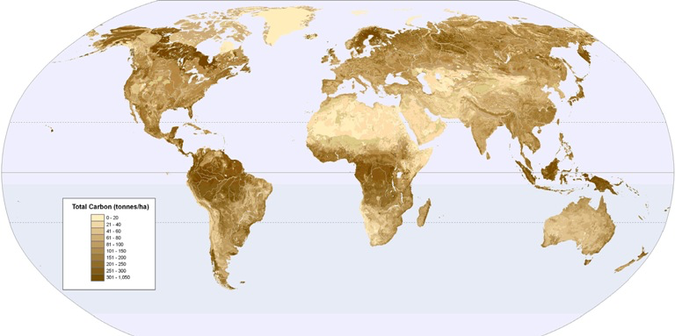
Climate
Temperature, moisture, CO₂, O₂
Determine weathering and soil formation

Slide 36
Organisms
Influence soil chemical and physical properties
Input litter quantity/quality
Uptake of mineral nutrients and input of organic nutrients
CO₂ combines with water to create carbonic acid

Slide 37
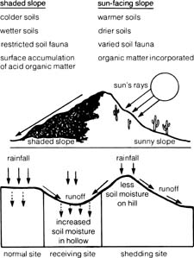
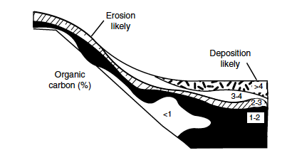
Topography
Influences climate, moisture availability, and particle transport

Slide 38
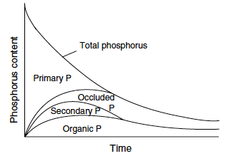
Time
Rocks weather slowly – minerals become occluded

Slide 39
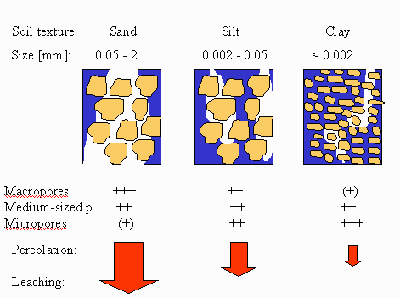
Soil Texture

Slide 40
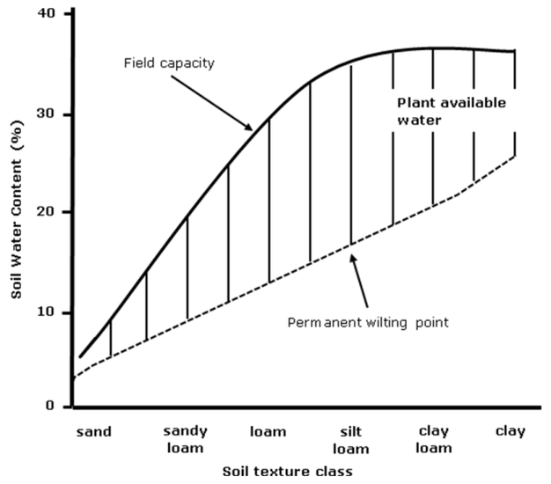
Physical: Soil texture
Sand: 0.05 – 2.0 mm
Silt: 0.002 – 0.05 mm
Clay: < 0.002 mm

Slide 41
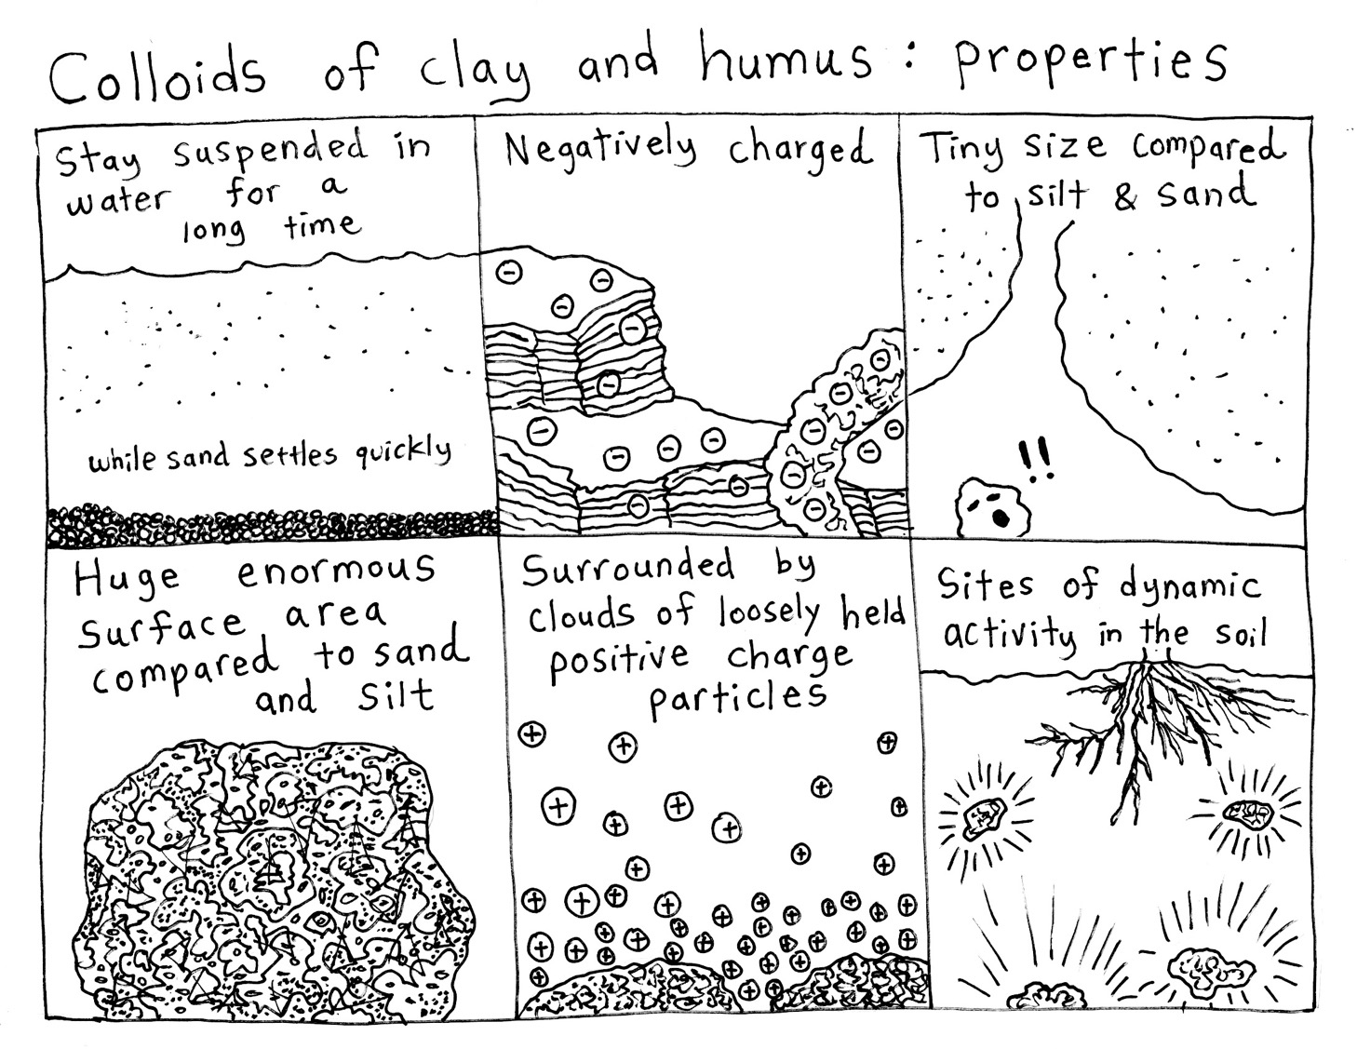

Slide 42
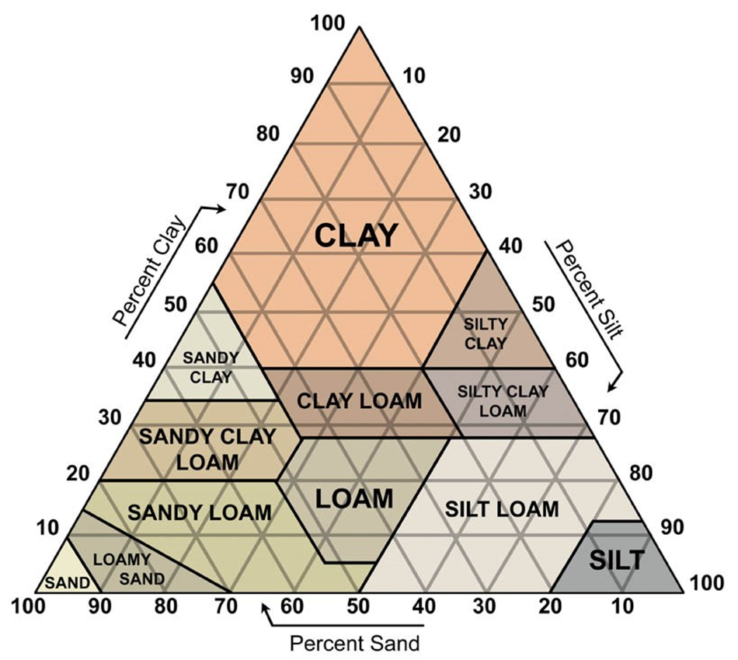
Physical: Soil texture

Slide 43
Chemical: Minerals weather in a specific order
Lower charge ---------------Higher charge
High CEC----------------------Low CEC

Slide 44
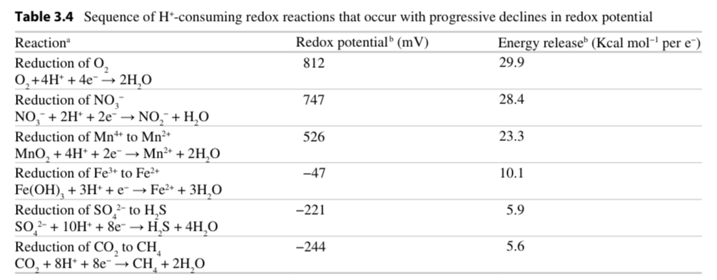
Chemical: Oxidation-Reduction
Redox = the process through which one substrance is reduced and the other is oxidized
OIL: Oxidation is loss – Fe²⁺ → Fe³⁺ + e⁻
RIG: reduction is gain – F₂ + 2e⁻ → 2F⁻

Slide 45
Chemical: Oxidation-Reduction
Transfer of electrons from one reactant to another
Organic matter is the largest donor
When oxygen is low, other donors become important (iron)

Slide 46
Chemical: Oxidation-Reduction
Redox can vary with:
Soil moisture
Pore size
CEC
Topography
Climate

Slide 47
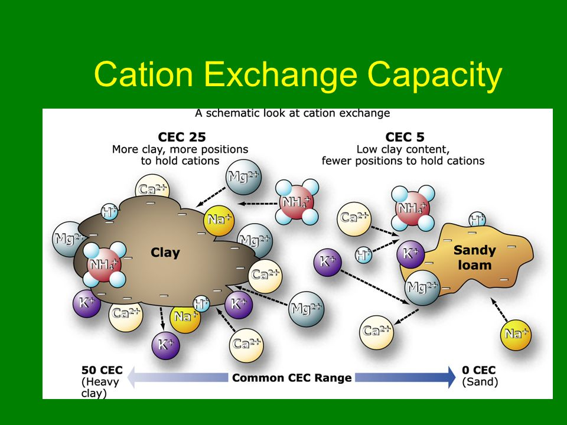

Slide 48
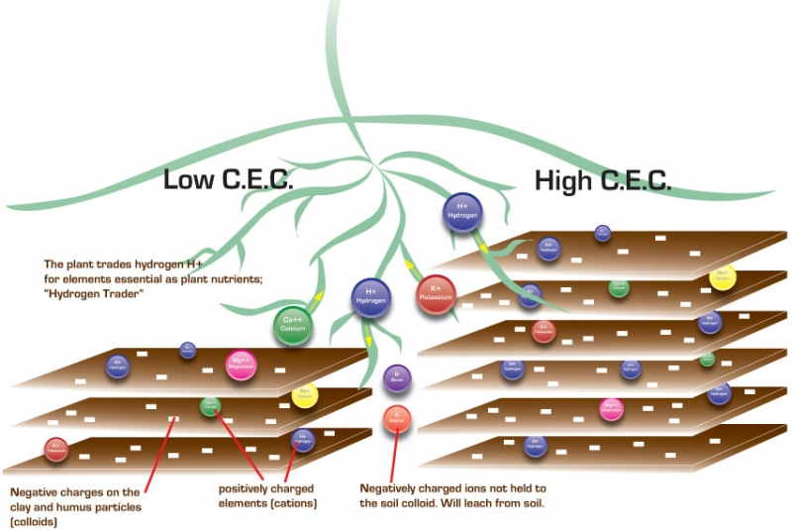

Slide 49
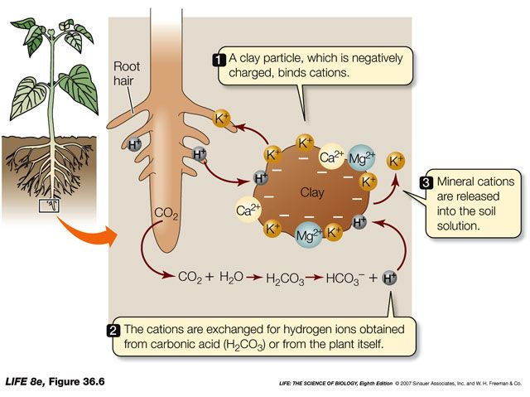
Chemical: Cation Exchange Capacity

Slide 50
Biomes

Slide 51
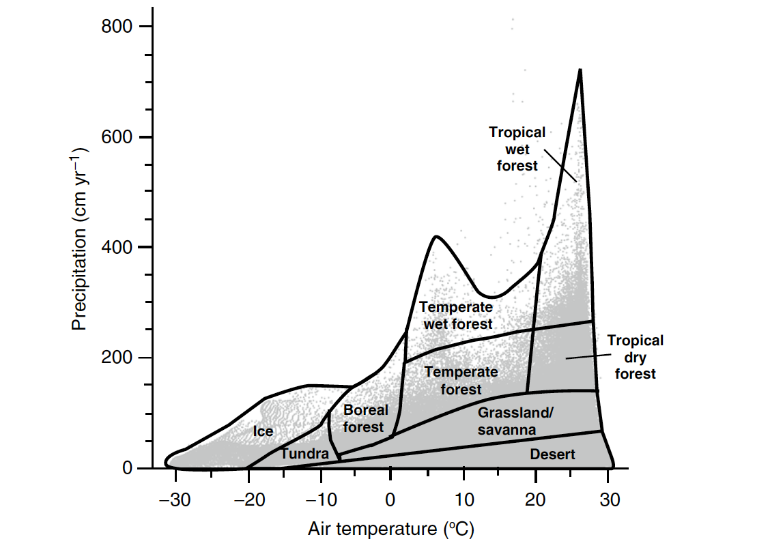
Climate determines biome distributions

Slide 52
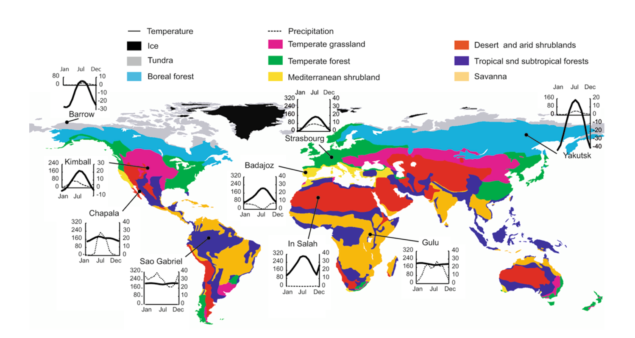
Biome distributions on Earth

Slide 53
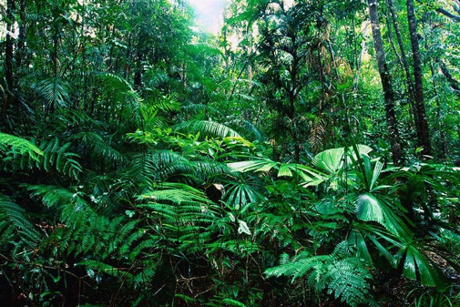
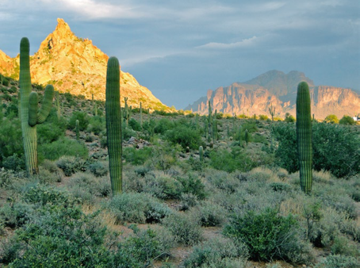
Characteristics of Biomes
Tropical Rainforest
Species diverse
Nutrient poor
Consistent climate
Desert
Bare soil
Calcium carbonate soils (basic)
Inconsistent climate

Slide 54
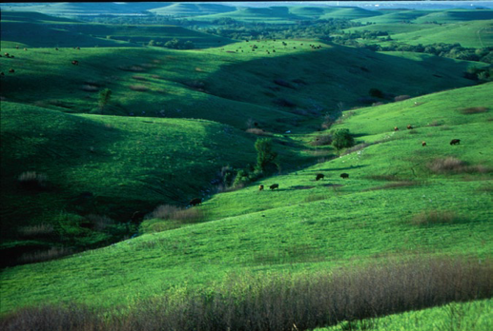
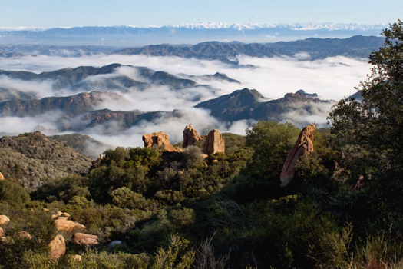
Temperate Grasslands
Clay soils
Deep soil carbon layer
Fire prone
Mediterranean shrublands
One of the most endangered habitats
Many endemic species
Only in coastal areas

Slide 55
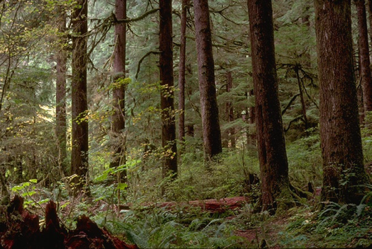
Temperate forests
Relatively species rich
Can have deciduous and non-deciduous trees
Taiga (Boreal forests)
Species poor
NPP in growing season can be as large as tropical forests
Experiencing warming at faster rates

Slide 56
What is our biome?

Slide 57
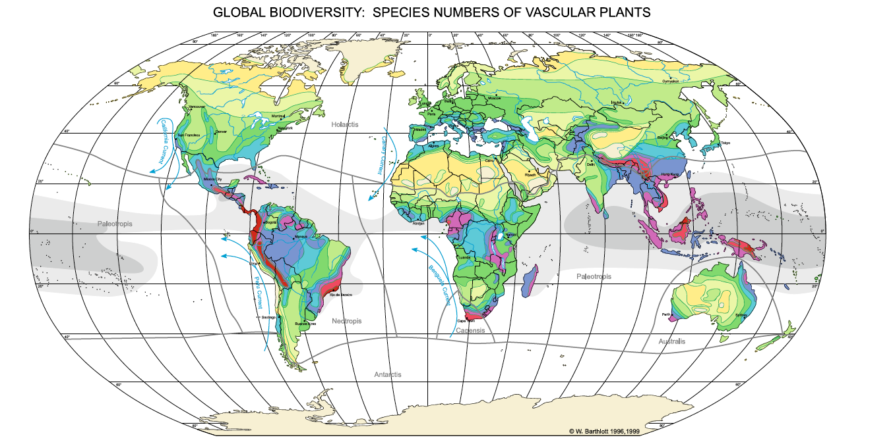
Latitudinal diversity gradient
Applies to plants and animals, but not necessarily microbes

Slide 58
Latitudinal diversity gradient
WHY?????
Applies to plants and animals, but not necessarily microbes

